Slide 1

Butler Final Project
Group J

Slide 2
Butler Final Project
Sirine Kheilfi
PowerBI/Tableau
Kyle O’Malley
Streamlit/Heroku/ML
Bill Taylor
SQL and other stuff

Slide 3
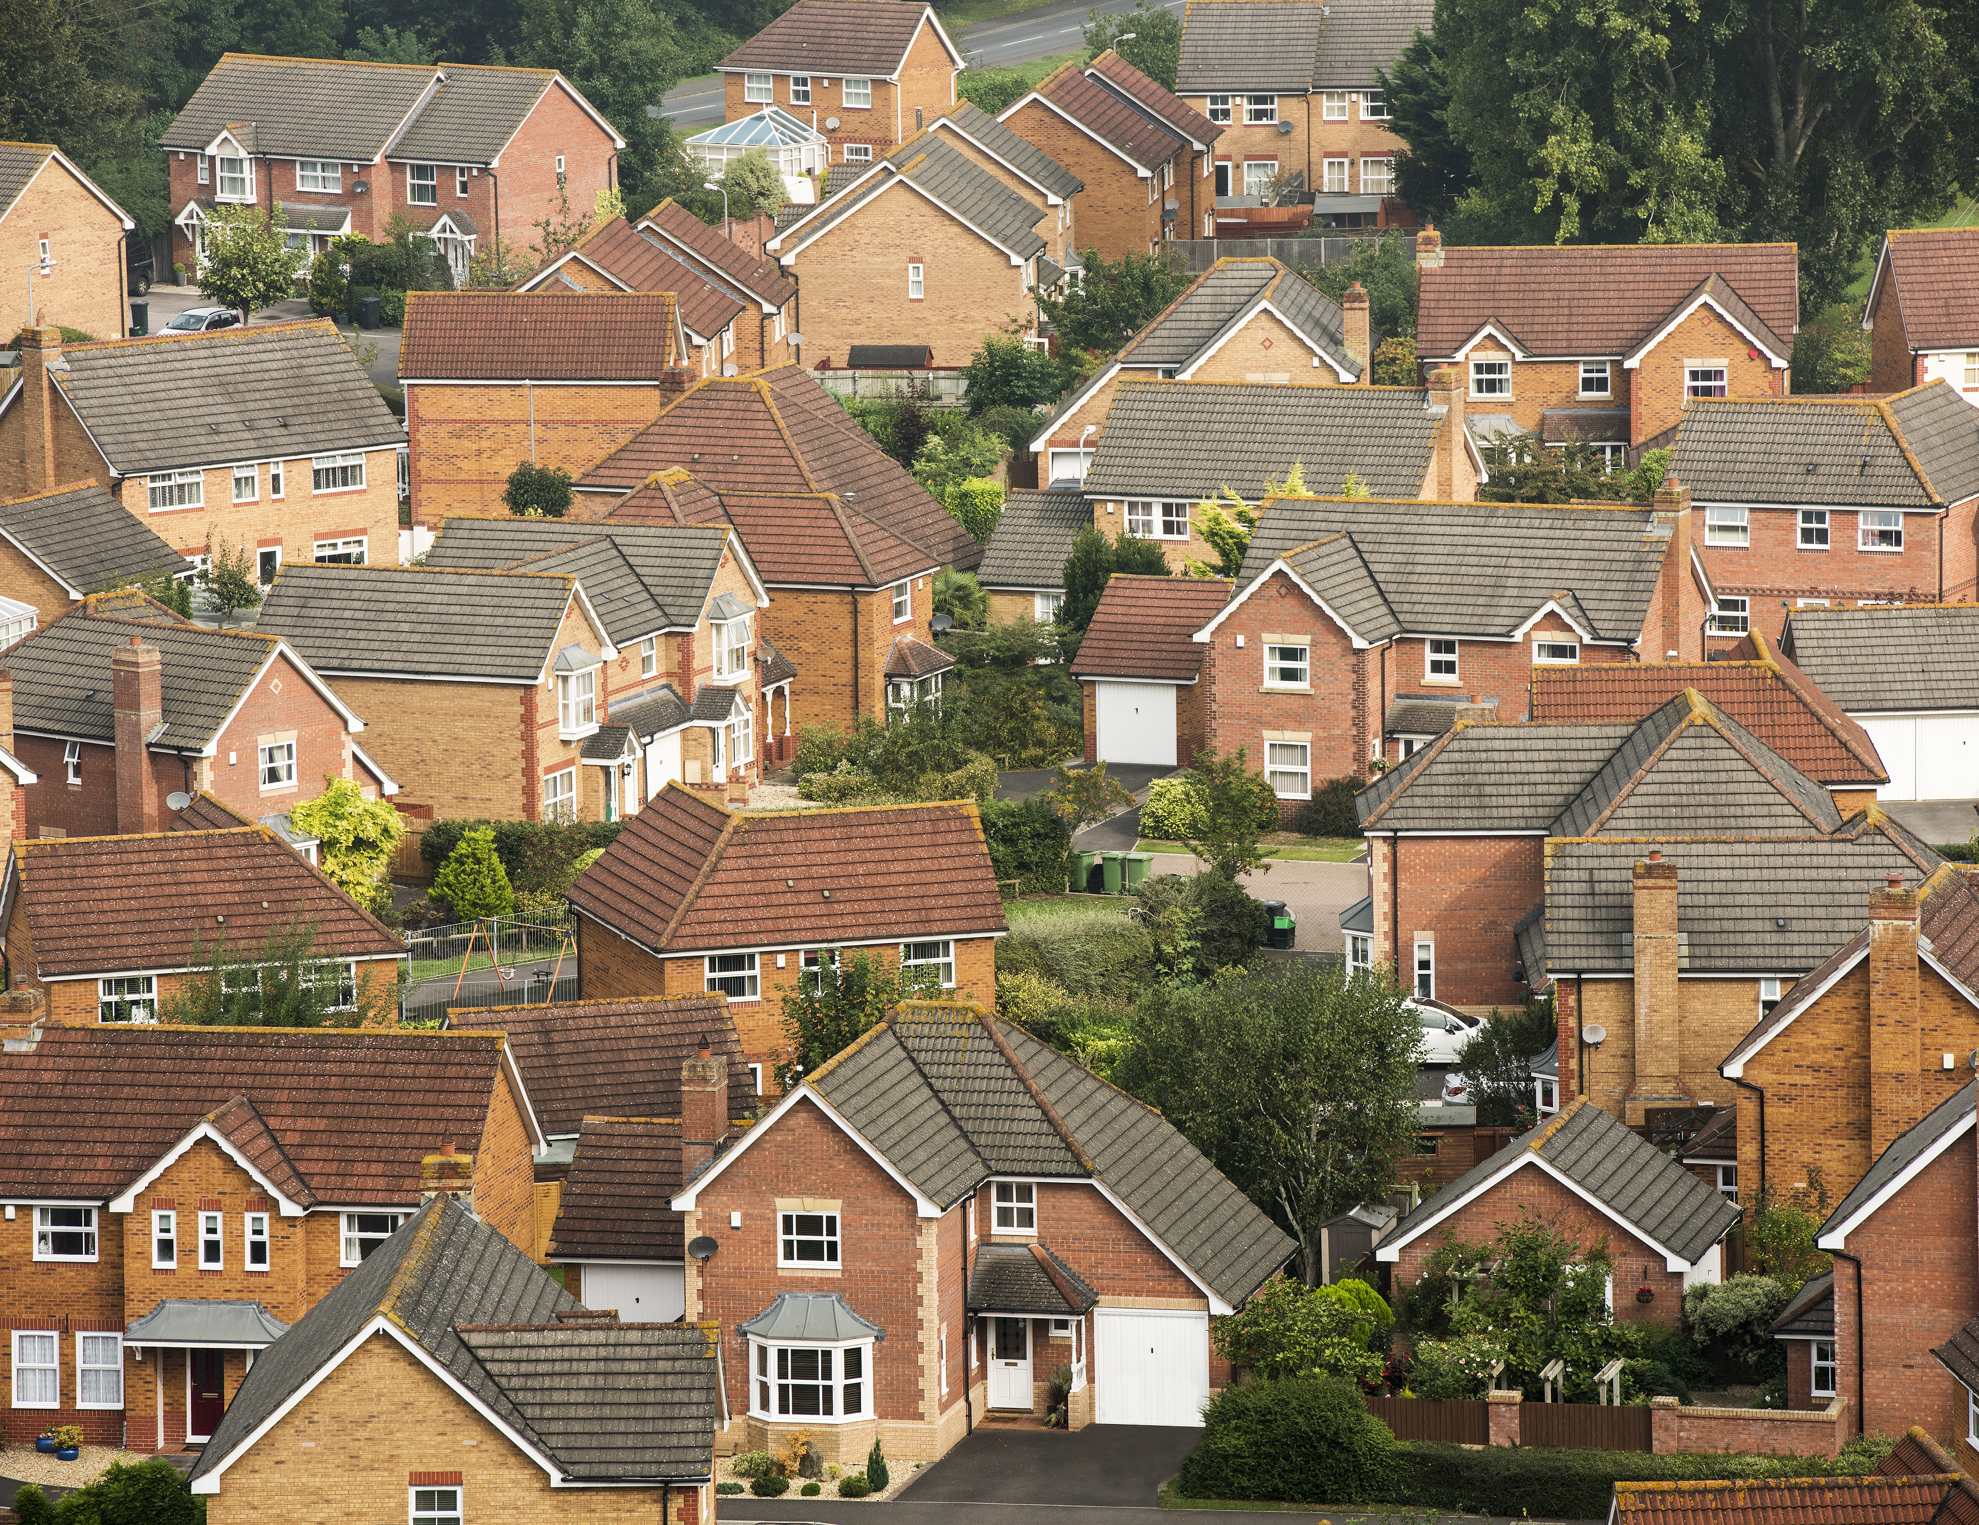
Home Value Predictor
For our question we wondered if there was a way to predict the future home averages, so we developed our app to learn how to predict it using past home values by month.
We are limiting the future to 3 years out.

Slide 4

Here is the app!
https://project3-groupj.herokuapp.com/

Slide 5

ETL Steps in postgresql and pandas
Notes:
Bill:
Download CSV data from https://www.zillow.com/research/data/ that has average home prices by zipcode from 1996 (the beginning of Zillow) to present.
Turned the data around in Pandas from very wide to narrow, expanding 36K rows to 9 million rows

Slide 6

Tableau steps and map
Notes:
Sirene:

Slide 7

Machine learning using SCIKIT and ONE-HOT
Notes:
Kyle:

Slide 8

Challenges/ Q&A

